Slide 1
Insights
Sales performance
Product analysis-Market basket analysis
RFM Customer segmentation
Time series prediction
SQL Questions
Tableau link-https://public.tableau.com/app/profile/shivangi.verma3226/viz/Online_Retail_dashboard/Dashboard1?publish=yes

Slide 2
Sales Performance

Slide 3
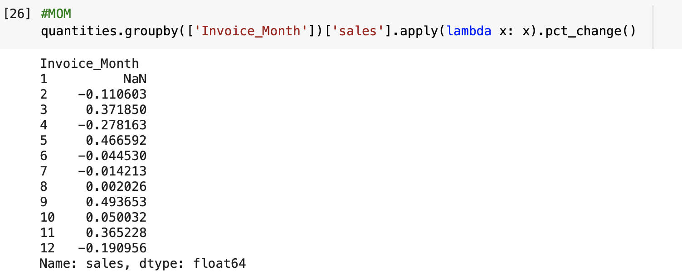
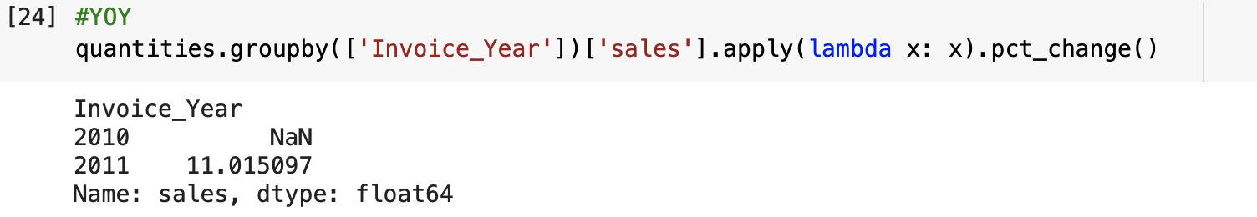
YOY and MOM
YOY shows 11% growth since 2010 ,While MOM calculation shows Month of september has the highest growth of 49% since last month

Slide 4
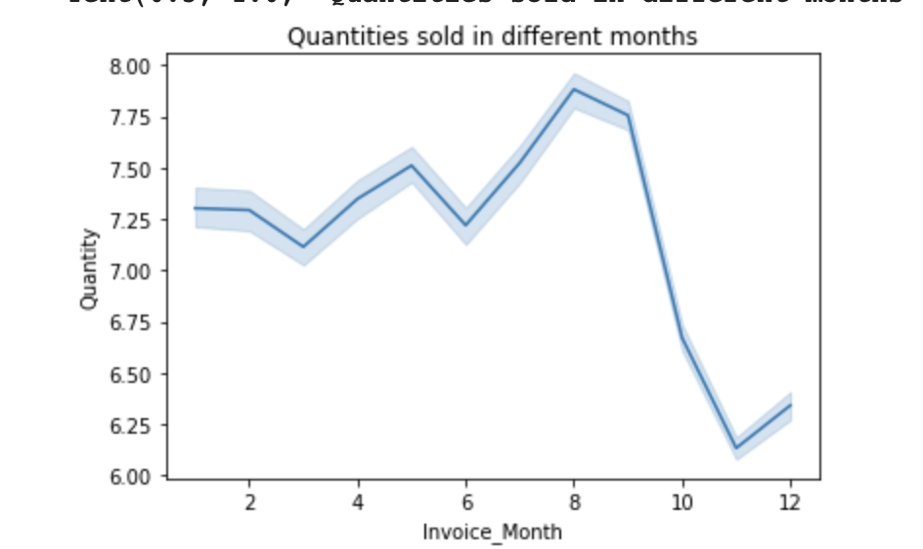
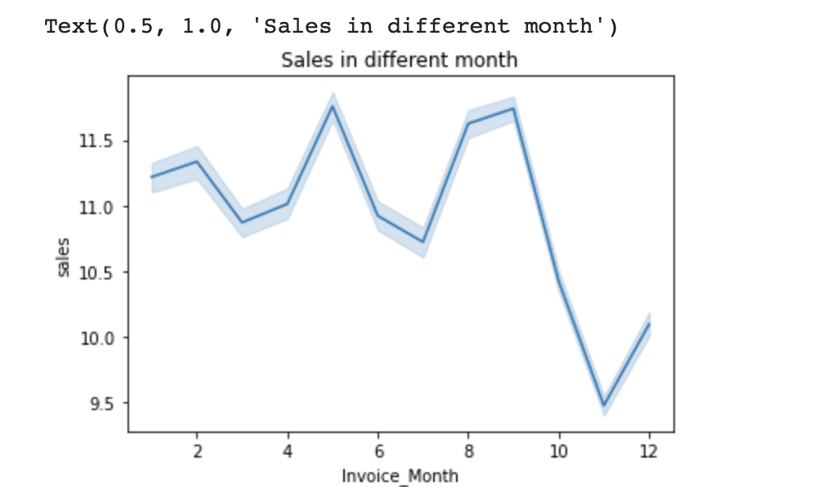
Comparing both charts there is a huge dip after October in sales and quantities sold while period between August to November is a good time for selling .

Slide 5
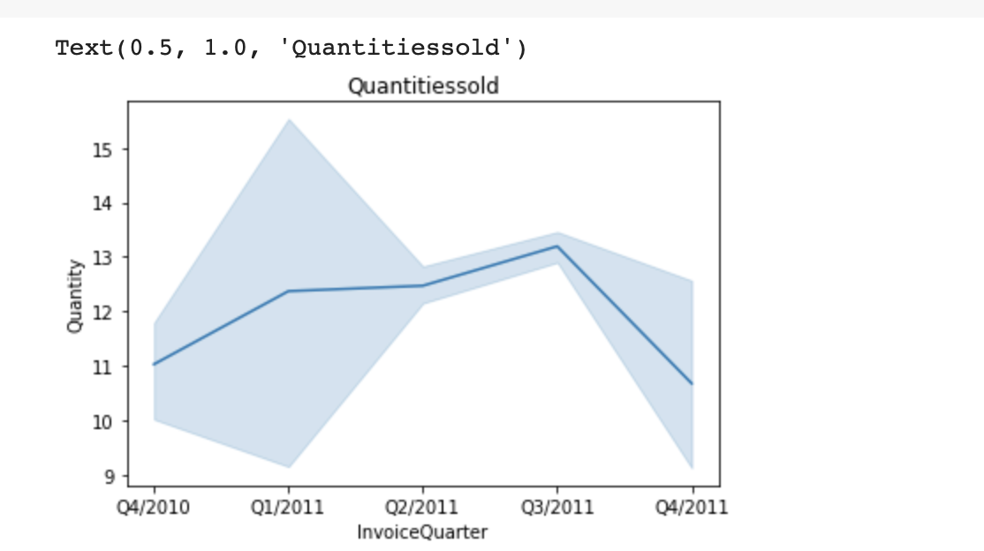
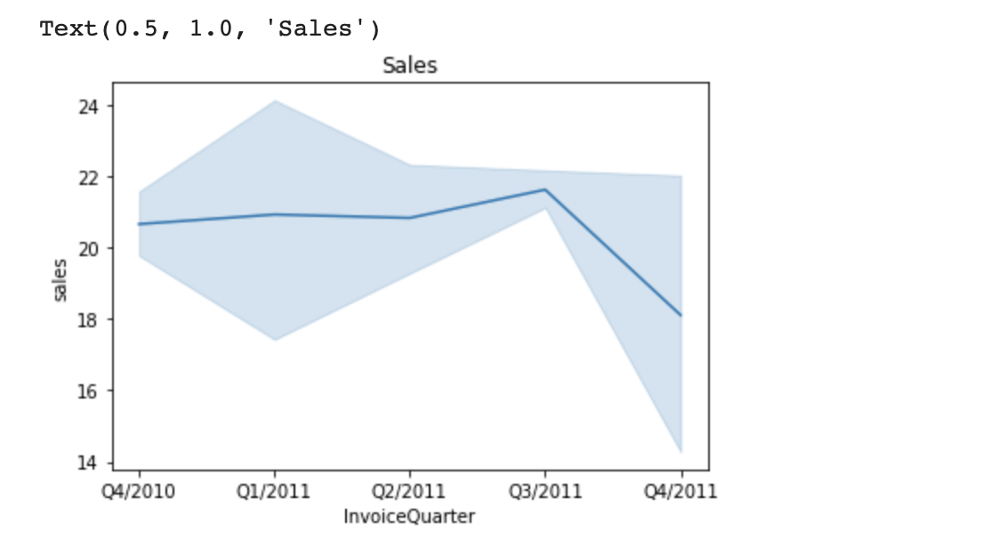
Quarterly sales ,Again confirming that Q3 is the best performing of the year

Slide 6
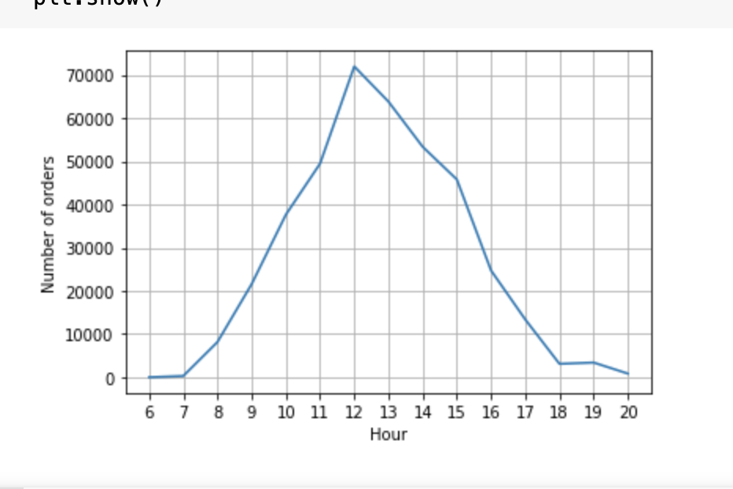
Between 11:00 am to 3:00 pm majority of sales occur

Slide 7
Conclusions
Q3 is the best quarter to sell
Time between 11:00 am to 3:00pm is the best time to suggest offers to link customers like afternoon sale or points for link members when they buy at this time of the day

Slide 8
Product analysis

Slide 9
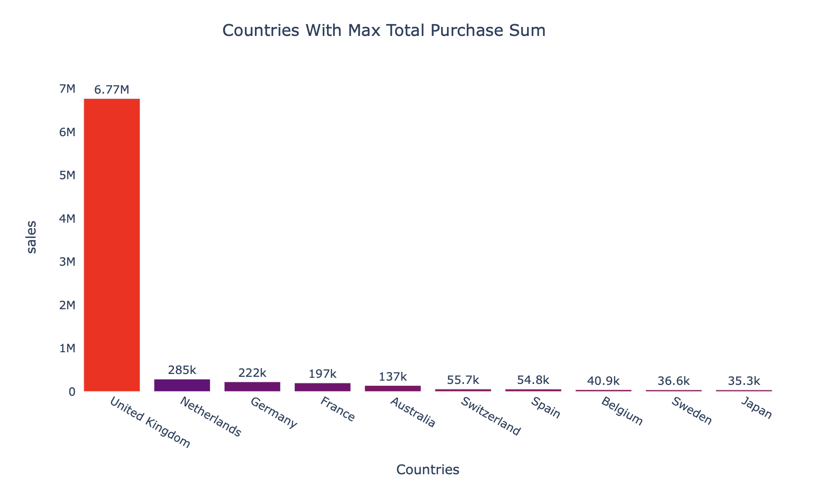
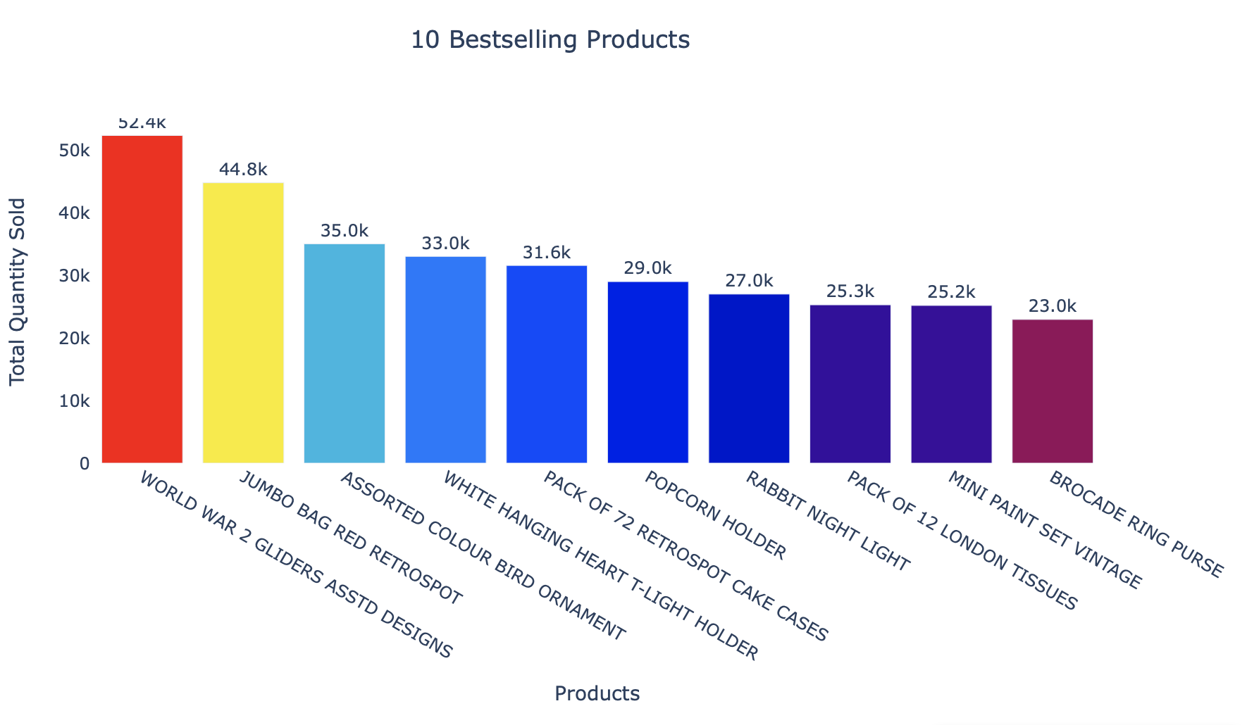
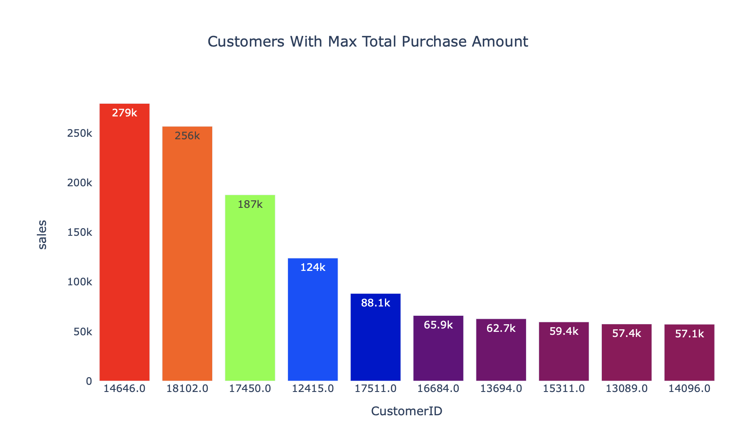

Slide 10
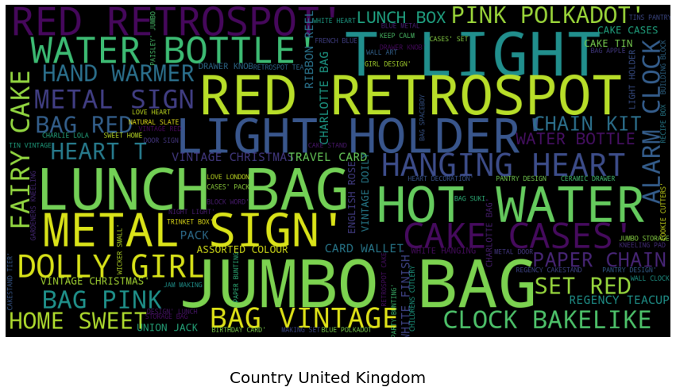
Word cloud on products bought in United Kingdom. This picture suggests that Jumbo Bag,Lunch Bag,Retrospot are the top products

Slide 11
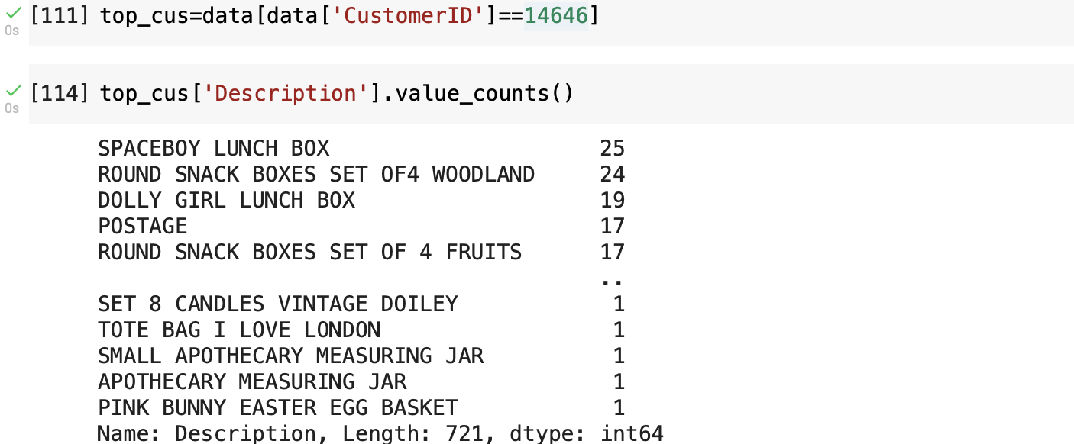
What did the top customers buy?

Slide 12
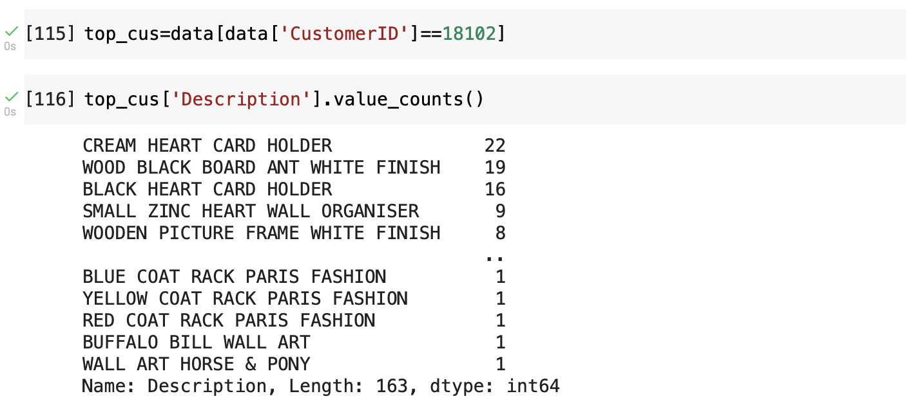

Slide 13
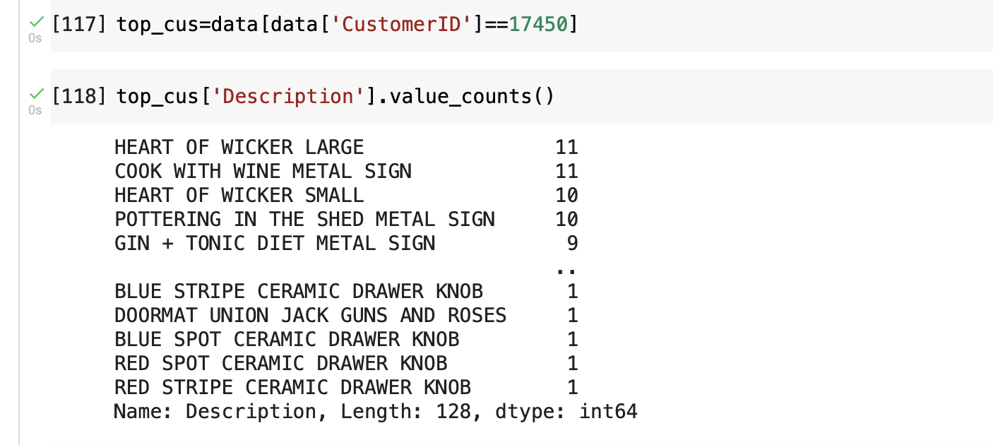

Slide 14
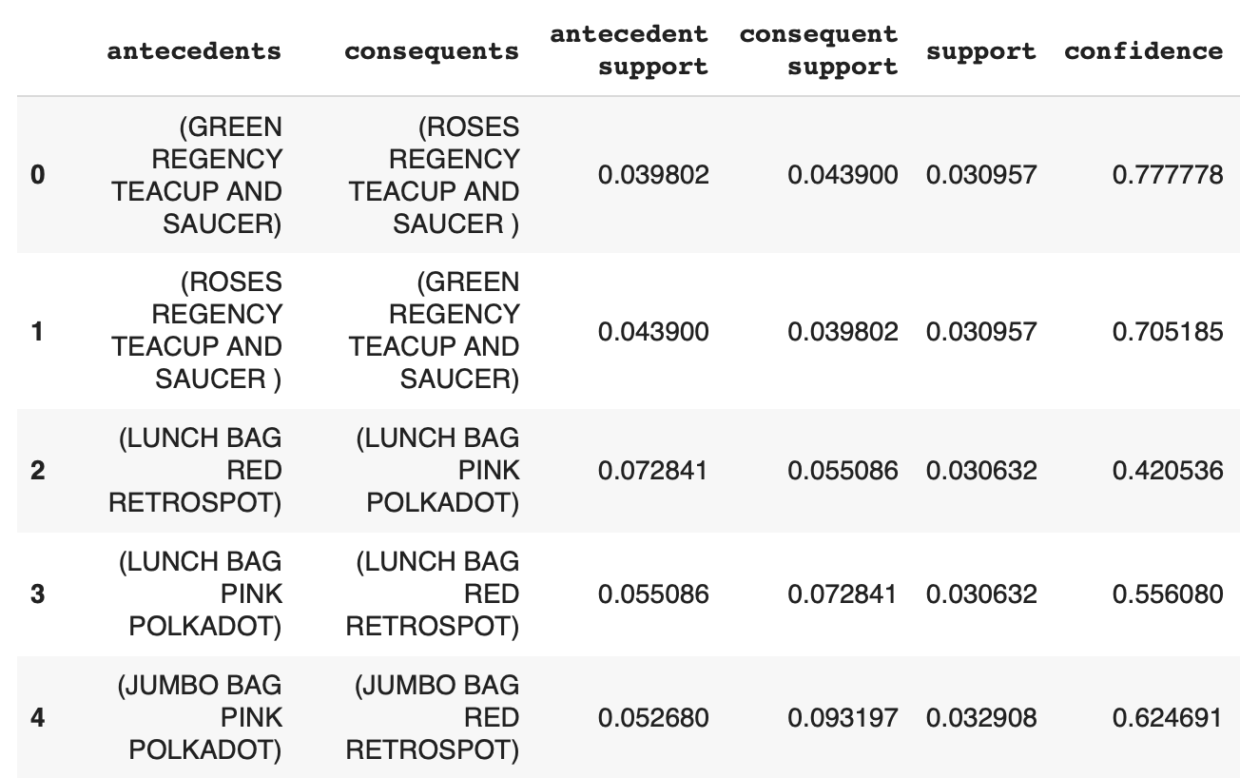
What is often bought together?
Since UK dominates the market,analyzing what items are bought together
So Green Regency tea cup and saucer and Rose regency tea cup and saucer can be placed nearer to each other in shelves ,discounts can be given on them as a package

Slide 15
Conclusions
UK Dominates the sales
Customer id 14646 has bought almost 279k The top customers can be targeted for link membership promotions or be given a loyalty card
World war 2 gliders and jumbo bag were the top products sold.
The top 3 customers individually bought spaceboy lunch box,cream heart card folder,heart of wicker large respectively.
Green Regency tea cup and saucer and Rose regency tea cup and saucer can be placed nearer to each other in shelves ,discounts can be given on them

Slide 16
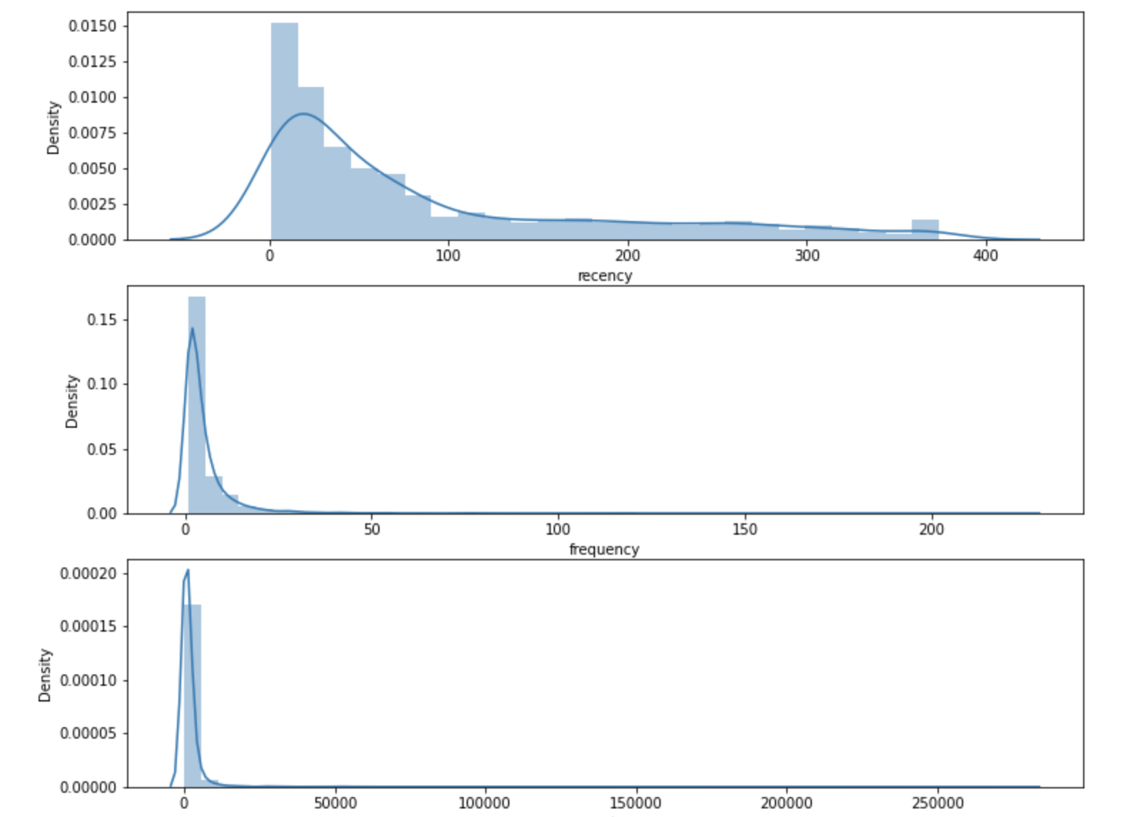
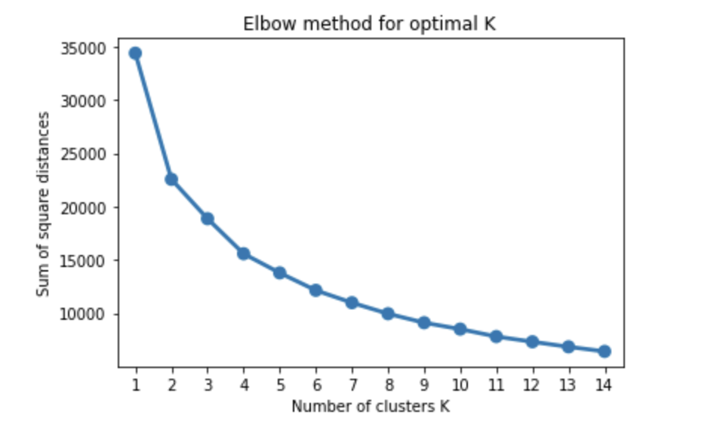
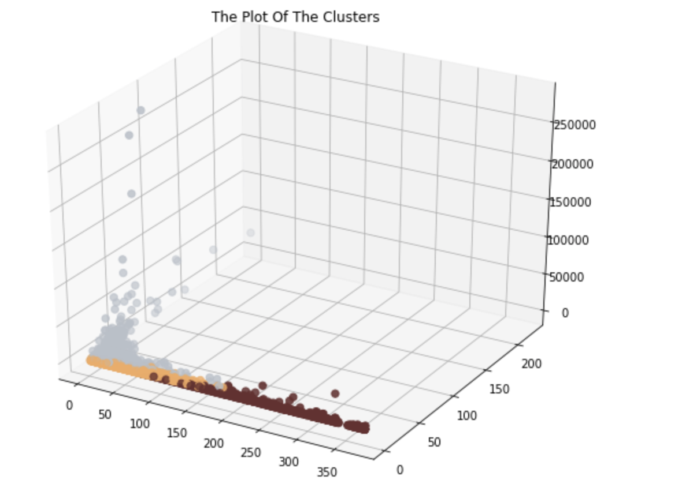
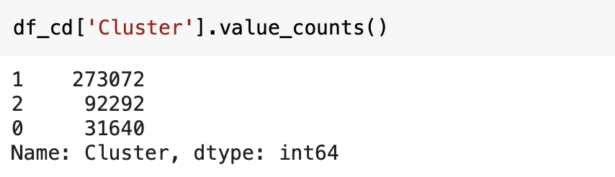
RFM Segmentation(Clustering)
Cluster 0-Recency is very high,Frequency is low ,Monetary is low
Cluster 1-Recency is low,Frequency is low,Monetary high
Cluster 2-Receny is low,Frequency is high,Monetary low

Slide 17
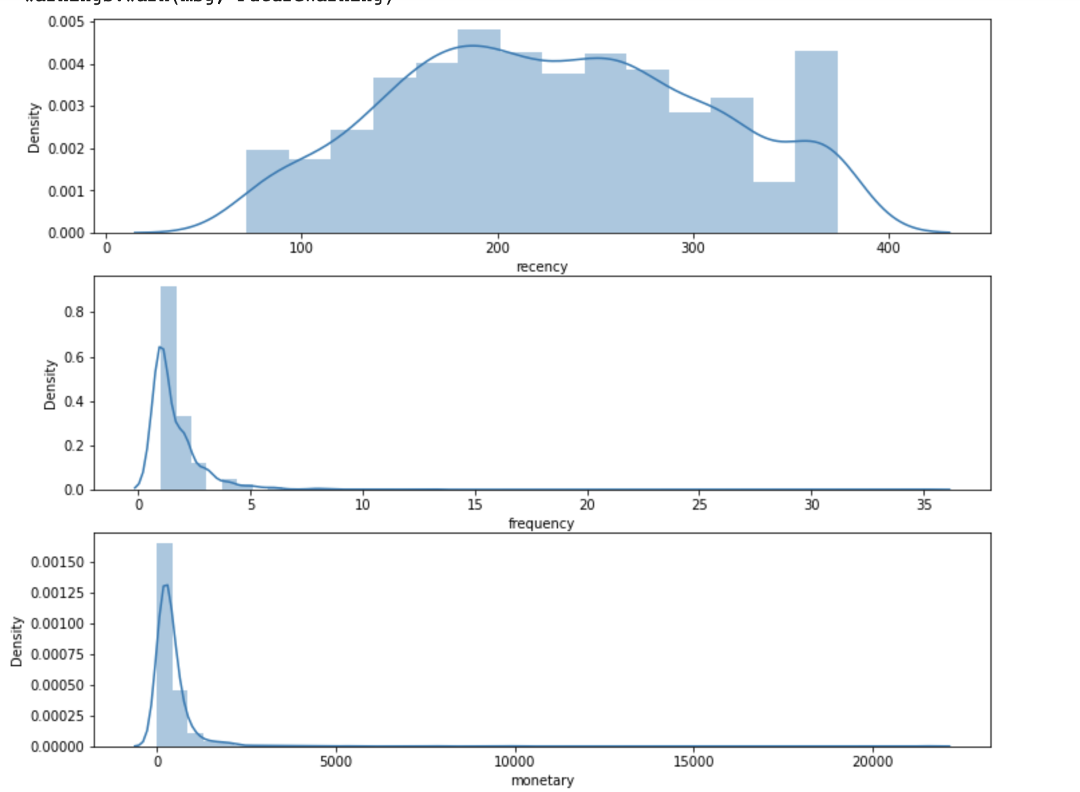
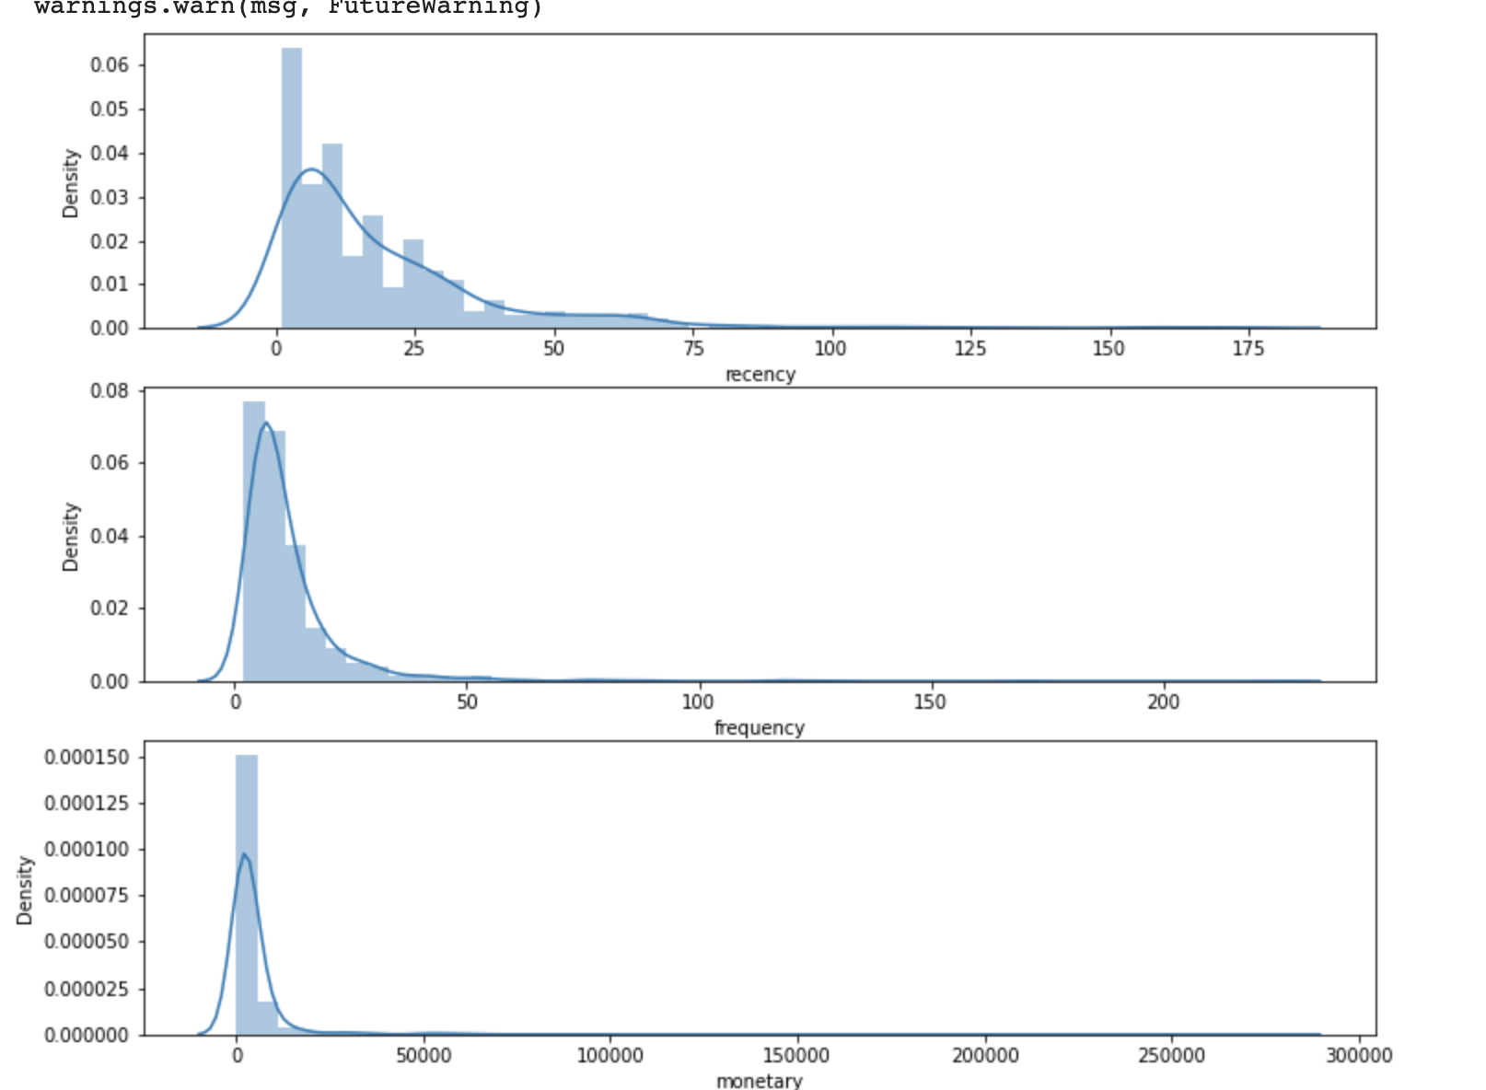
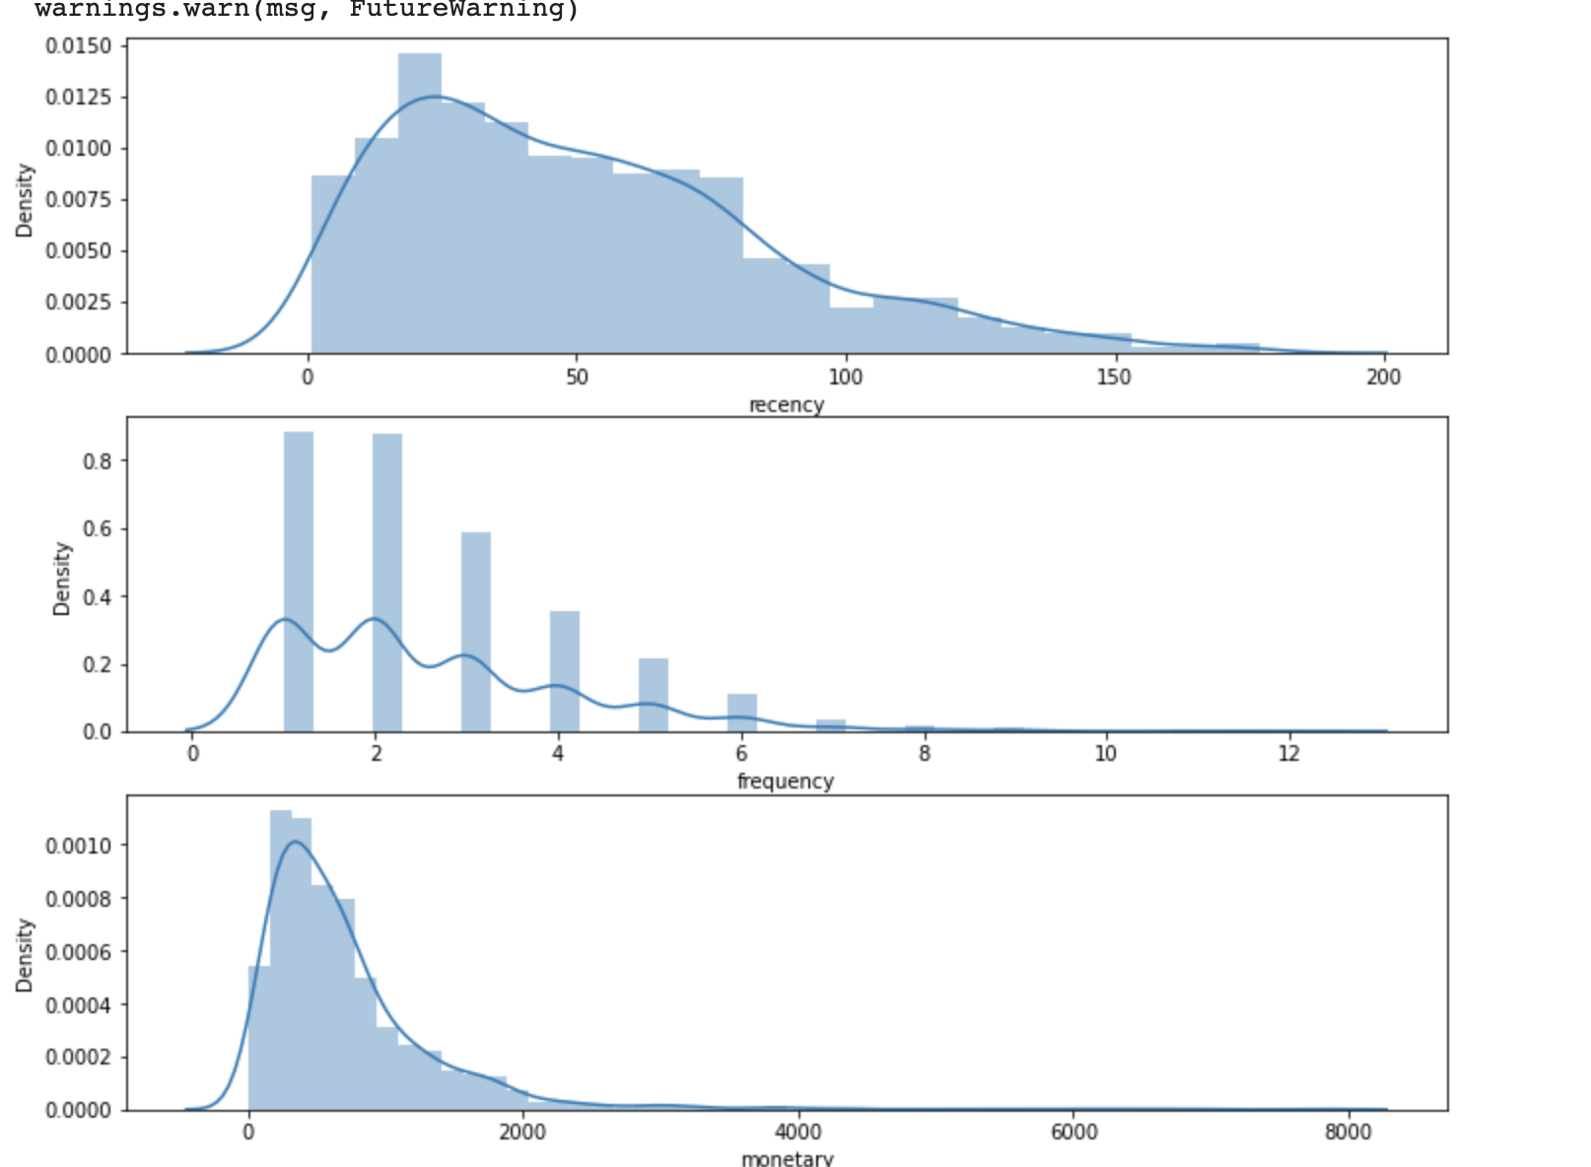
Cluster 0
Cluster 1
Cluster 2

Slide 18
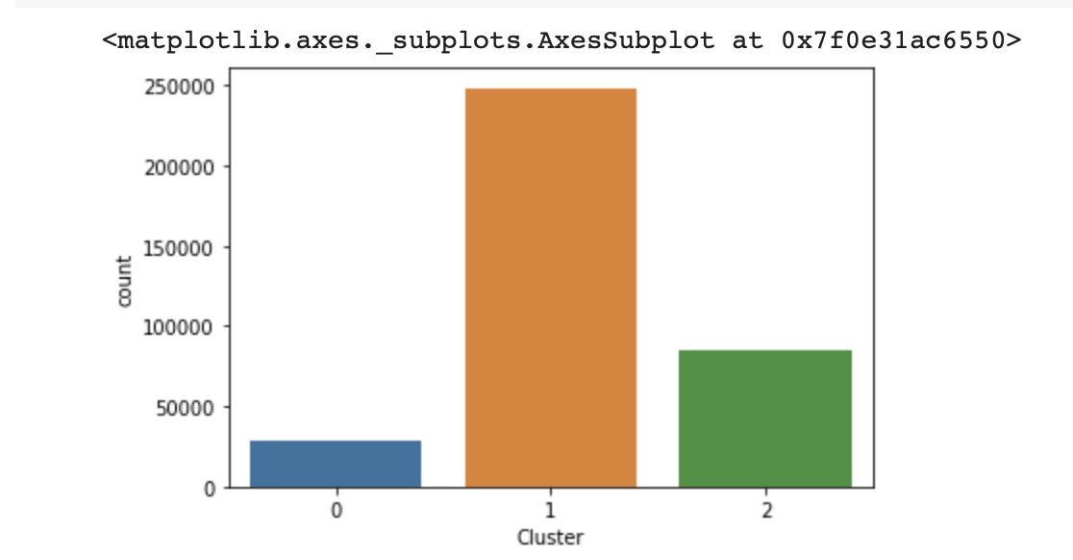
Cluster distribution in United Kingdom

Slide 19
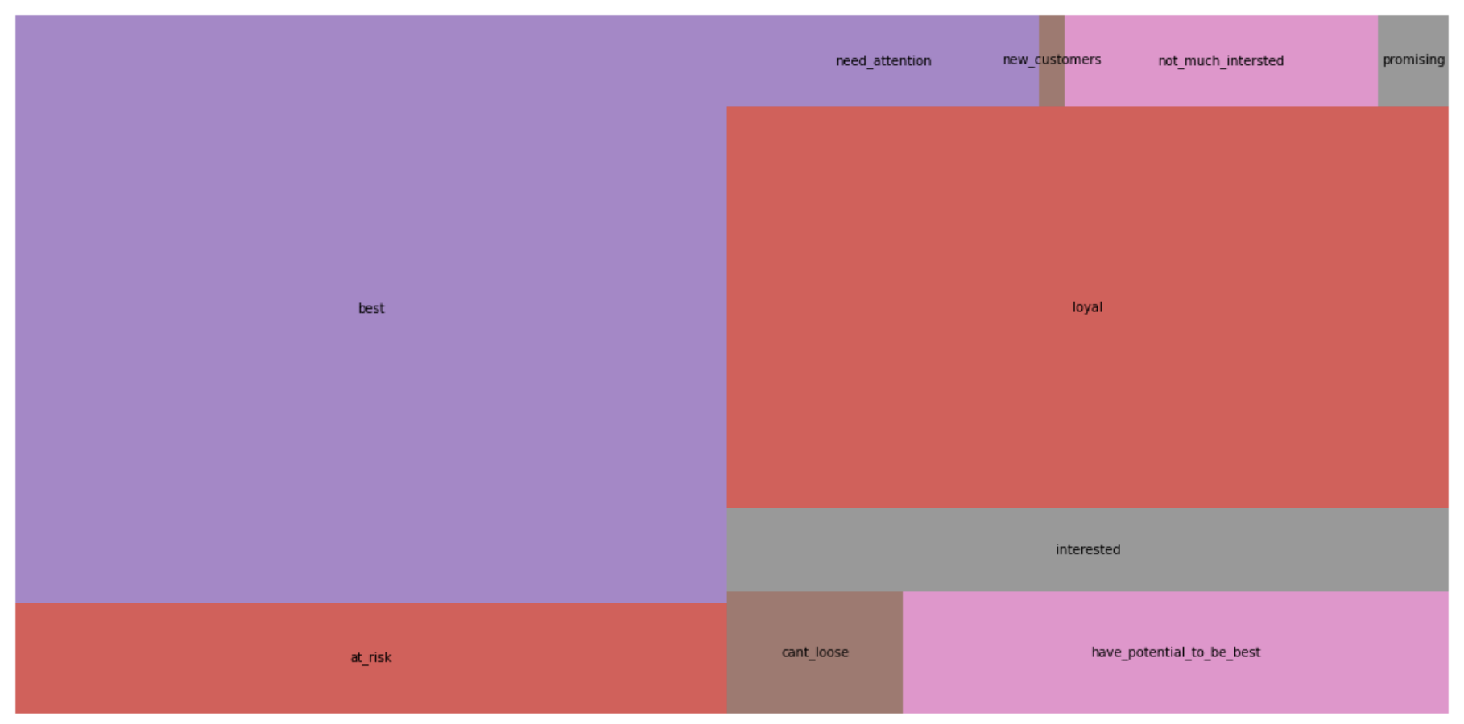
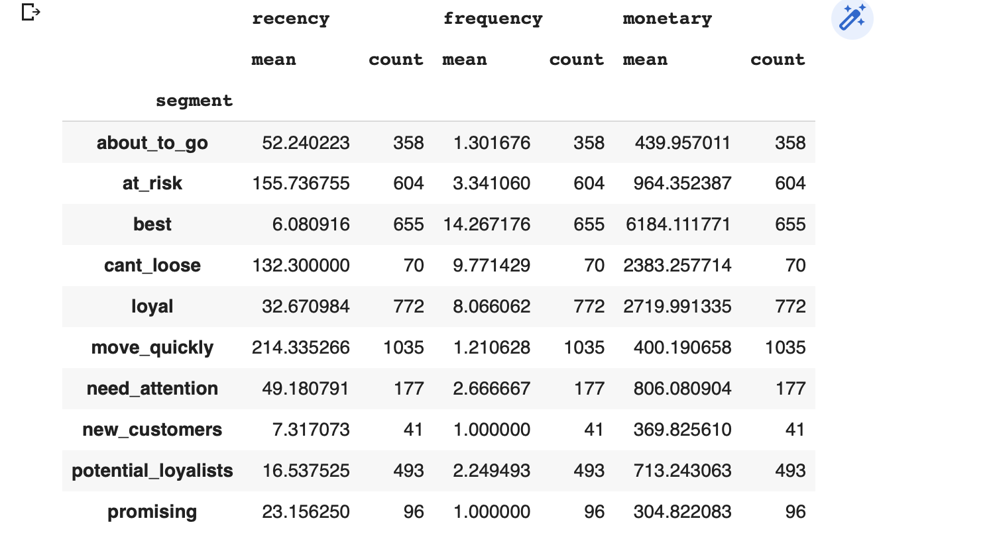
Segmentation using rfm scores

Slide 20
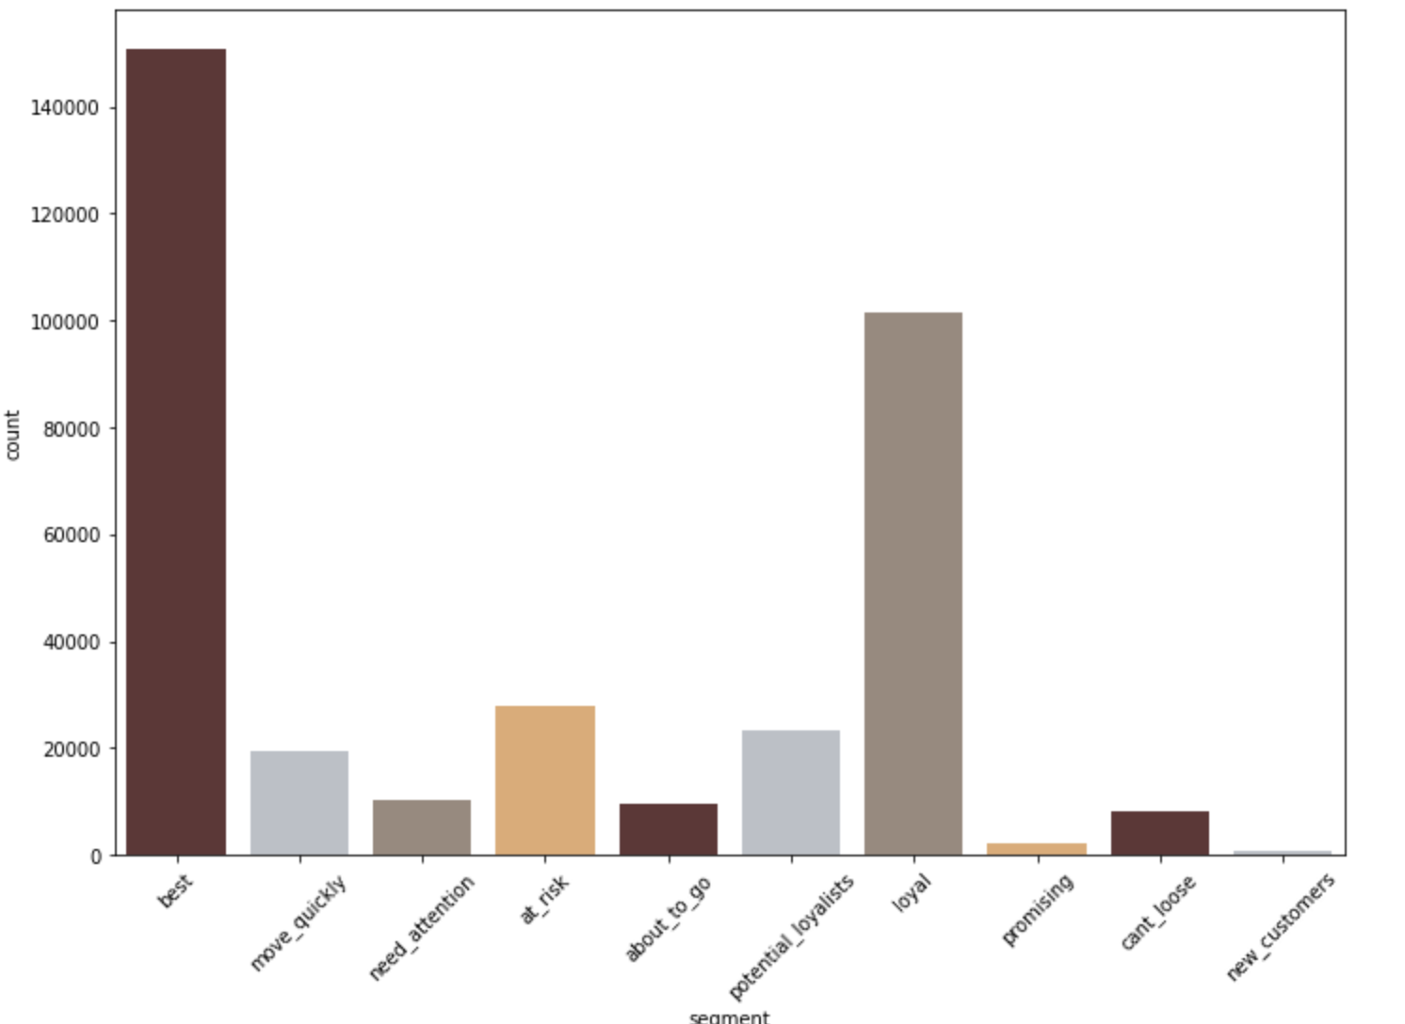
UK

Slide 21
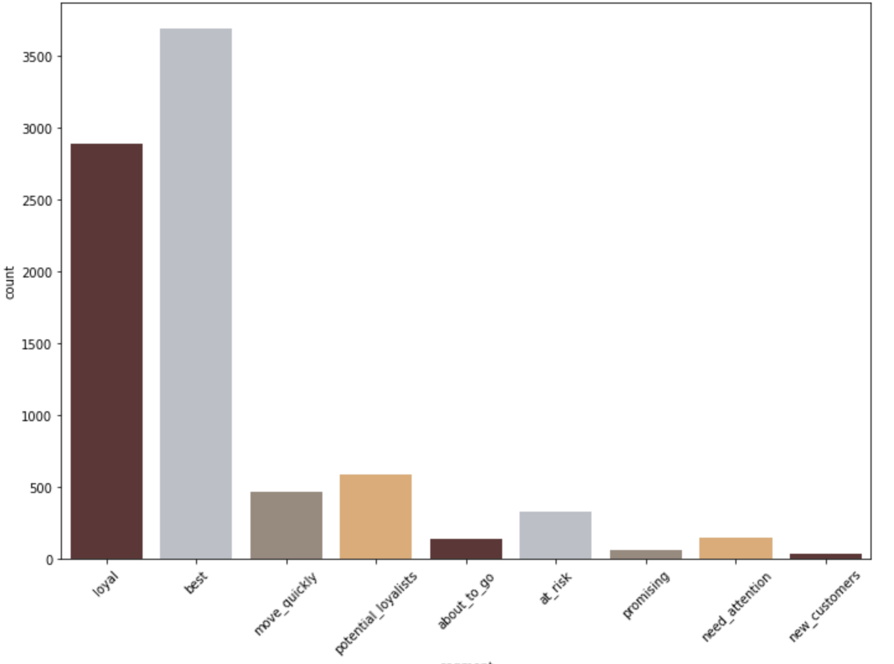
France

Slide 22
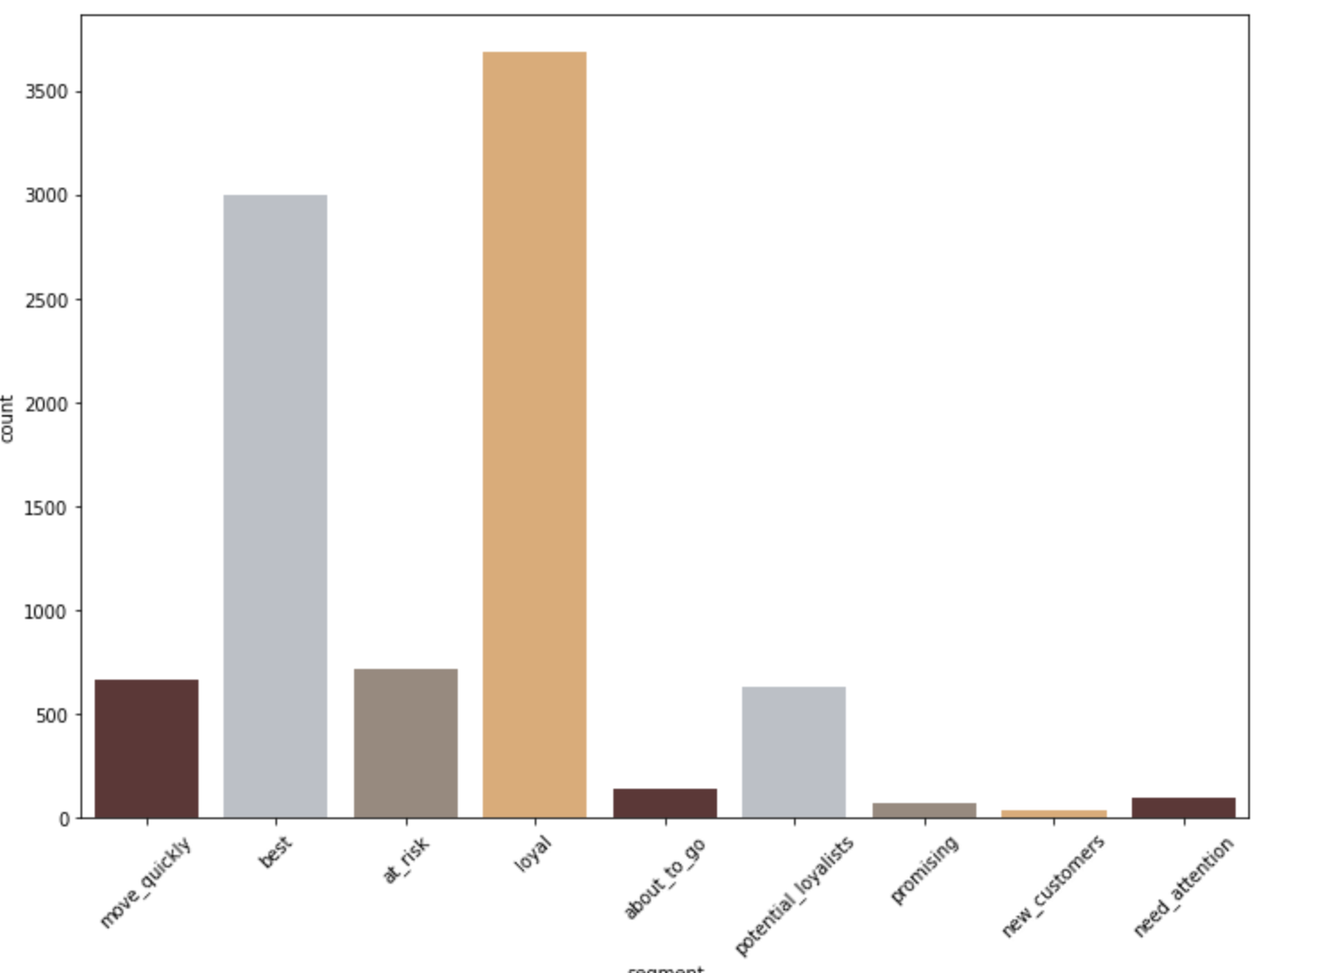
Germany

Slide 23
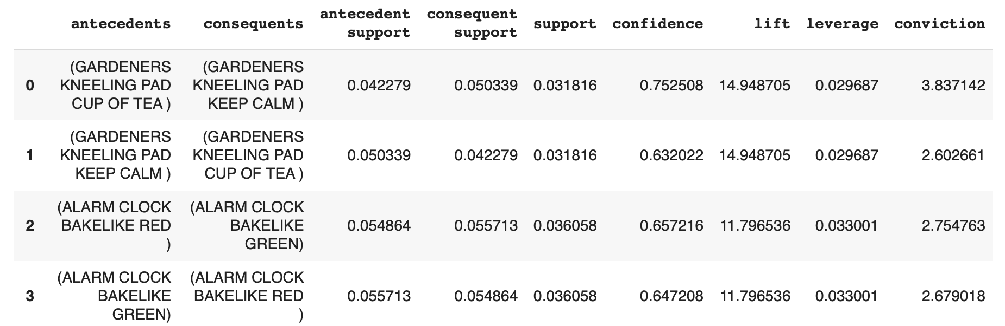
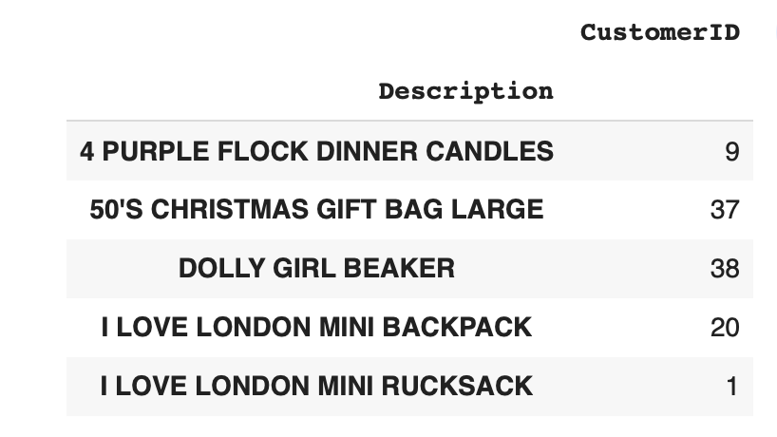
What did the best customers buy and what did they buy together?
Best customers bought Dolly girl beaker,50's christmas gift bag
They bought Gardners kneeling pad cup of tea and kneeling pad together

Slide 24
Conclusions
Based on clustering ,3 main clusters can be seen
United kingdom shows high count of customers belonging to cluster 1 which is high monetary ,this might be due to a large chunk of customers are from UK.
Using rfm score and making segments manually 10 segments are defined.
United Kingdom shows high number of best customers and loyals.These customer profiles can be targeted for link membership cards or promotions and offers.
Best customers and potential loyalists can be suggested to convert to loyals
Best customers bought Dolly girl beaker,50's christmas gift bag
They bought Gardners kneeling pad cup of tea and kneeling pad together

Slide 25
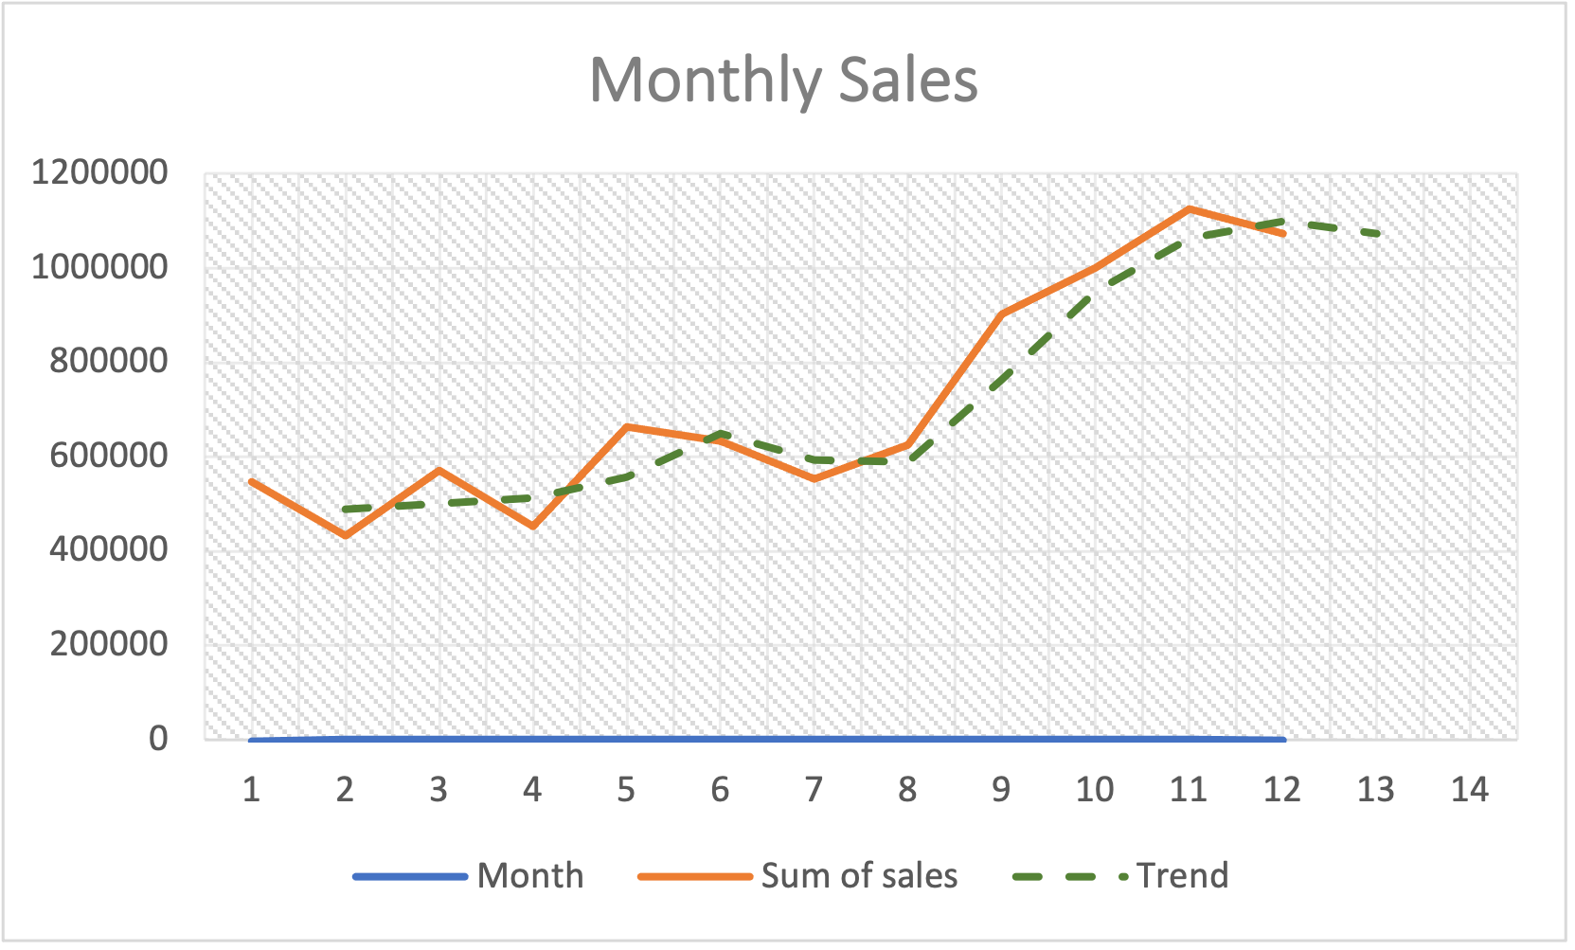
Prediction
Using Moving average for two periods and smoothening ,the trend line shows that next year the sales might be between 1million to 12 million (a rough estimate)

Slide 26
INSIGHTS DRAWN
UK dominates the revenue, we can use this information to give uk specific offers on festivals etc
Third quarter is best time to get more sales historically.
Time between 11 am to 3pm is the time period where most sales are made,offers valid during this time can be made to attract customers
United kingdom has a large number of best customer segment ,these can be converted to loyals to drive more revenue.
Customer id 14646 has bought almost 279k The top customers can be targeted for link membership promotions or be given a loyalty card
For product placement -Green Regency tea cup and saucer and Rose regency tea cup and saucer can be placed nearer to each other in shelves ,discounts can be given on them if bought together
Best customers bought Dolly girl beaker,50's christmas gift bag,discounts on this item can be used to attract them next time.
They bought Gardners kneeling pad cup of tea and kneeling pad together,this information can be used to give them offers if they bought this together.

Slide 27
SQL Questions

Slide 28
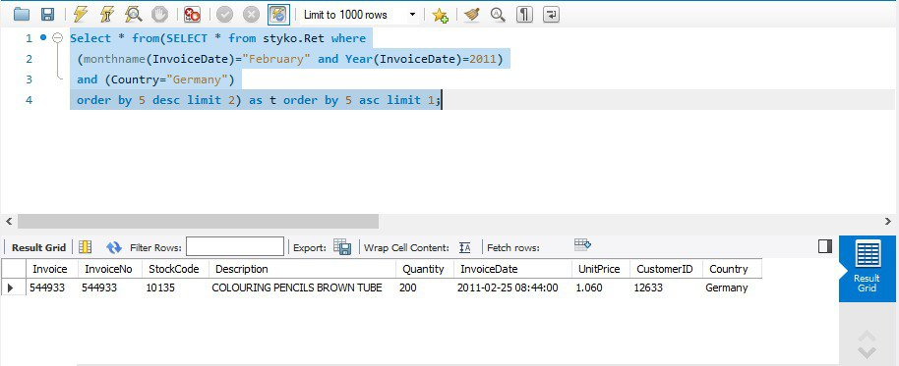
Write a sample query to find the second most purchased item in Germany in Feb 2011.

Slide 29
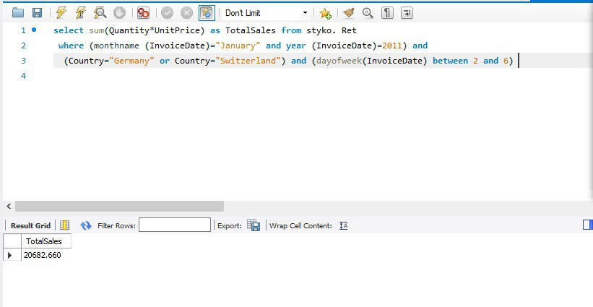
Sample query to find the total sales during weekdays in the month of Jan 2011, in Switzerland & Germany.

Slide 30
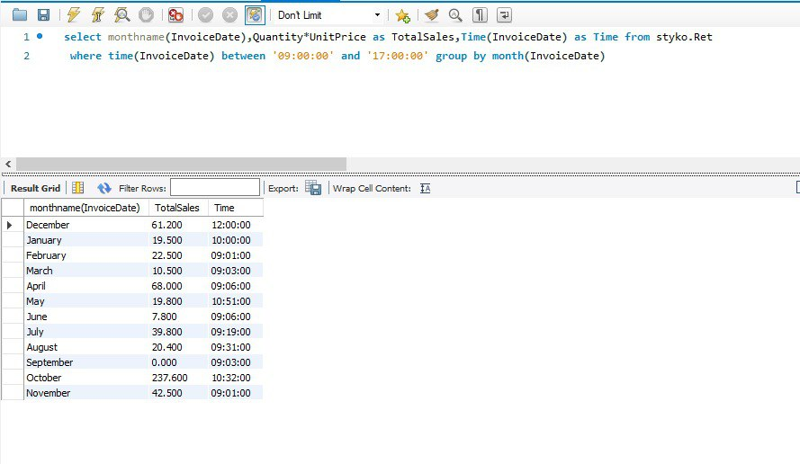
Find monthly sales which happen between 9am and 5pm.

